Slide 1
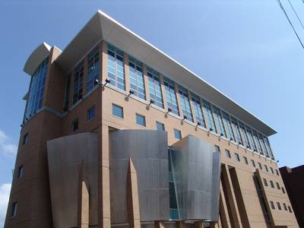
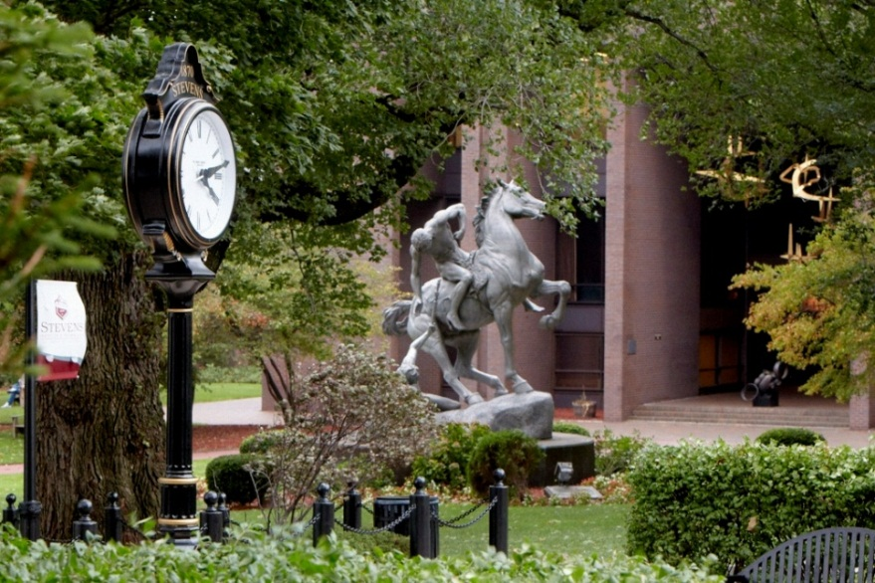

Stevens Institute of Technology
Internet of Things (IoT)
TM610 Bonus Lecture
Dr. Kevin Ryan and Dr. Mahmoud Daneshmand
kryan@stevens.edu

Slide 2
Overview
Internet of Things
Overview
Definition
Applications
Role of sensors and actuators
Embedded systems
With network access
Role of 5G mobile wireless networks

Slide 3
Overview; The Internet of Things
The future of the Internet
A significant increase in the interconnection of “devices”
These devices will include sensors
Impact
New applications
Gathering of data
The world of “big data”
New Internet architecture
This new architecture is referred to as “IoT”

Slide 4
IoT
Technology development in a number of important areas including
Sensors
Healthcare
Transportation
Inventory control
Low-power operation of devices and networks
Concerns include;
Security and privacy

Slide 5
IoT (cont.)
A global infrastructure
“Things” or “Devices” may include the following capabilities;
Sensing
Actuation
Data capture
Data storage
Data processing
Communication can now be;
Directly between devices

Slide 6
Internet of Things (IoT)
The term was first proposed by Kevin Ashton, a British technologist, in 1999, when he was Executive Director at MIT’s Auto-ID Center, an RFID research consortium
The IoT connects devices such as every day consumer objects and industrial equipment onto the network, enabling information gathering and management of data generated by these devices in order to increase efficiency, enable new services, or achieve other health, safety, or environmental benefits.
Billions of “things” such as sensors/RFID, mobility
devices & smart phones are generating mountains of
data on all aspects of the human life: health,
environment, transportations, security, shopping,
marketing, smart cities, smart grids, smart homes, etc.

Slide 7
Size
Morgan Stanley: 75 Billion Devices Will Be Connected To
The Internet Of Things By 2020.
There are 200 unique consumer devices or equipment that could be
connected to the Internet that have not yet done so.
Business Insider, Oct 2, 2013
Intel: 'Internet of Things' - a trend toward
connecting everything from bathroom scales to skyscraper
ventilation Systems via the Internet - will create massive
demand for new electronics and software.
Reuters, Nov 5, 2013

Slide 8
IoT Promise: Value Creation
No matter which vendor companies choose, the Internet of things has amazing growth projections:
Gartner predicts that the Internet of things and personal computing will unearth more than $1.9 trillion in revenue before 2020,
Cisco thinks there will be upwards of 50 billion connected devices by 2020

Slide 9
End-to-End IoT & Big Data
Big Data Measurement
Big Data Networking
Big Data Management
Big Data Analytics
Big Data Visualization
Big Data Privacy and Security
Edge/Fog Computing
Cloud Computing

Slide 10
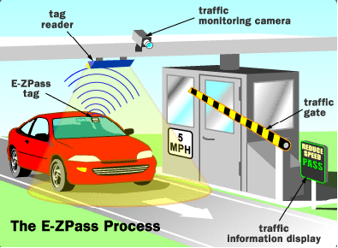
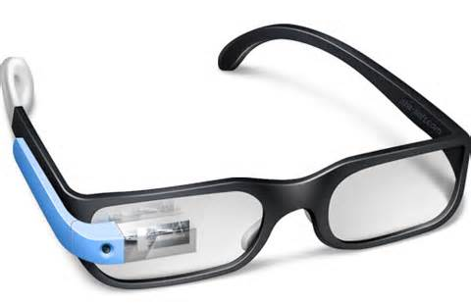
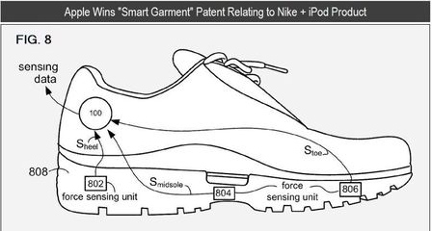
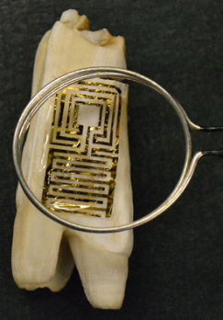
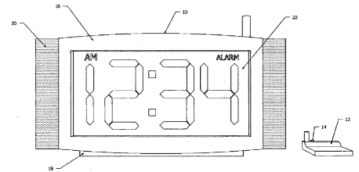
Example of Connected Things
Past: E-Zpass (Barcode, etc)
Today: Google Glass
Future: Apple’s Smart Garment (e.g. shoe)
-> automatic clothing suggestion for everyday based on weather, your business schedule, your body condition, etc
Future: Tooth Tattoo
-> put on cow’s teeth to detect disease wirelessly
-> from Princeton University
(http://www.princeton.edu/main/news/archive/S33/79/62E42/index.xml?section=topstories)
Future: Smart Clock
-> integrated with Bedpost Pressure Sensor
-> alarming only when the bed is occupied
-> Patent App 20110085423

Slide 11





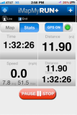
People Connecting to Things Source: Wei Wang, Cory Henson, Payam Barnaghi
ECG sensor
Internet
Motion sensor
Motion sensor
Motion sensor

Slide 12
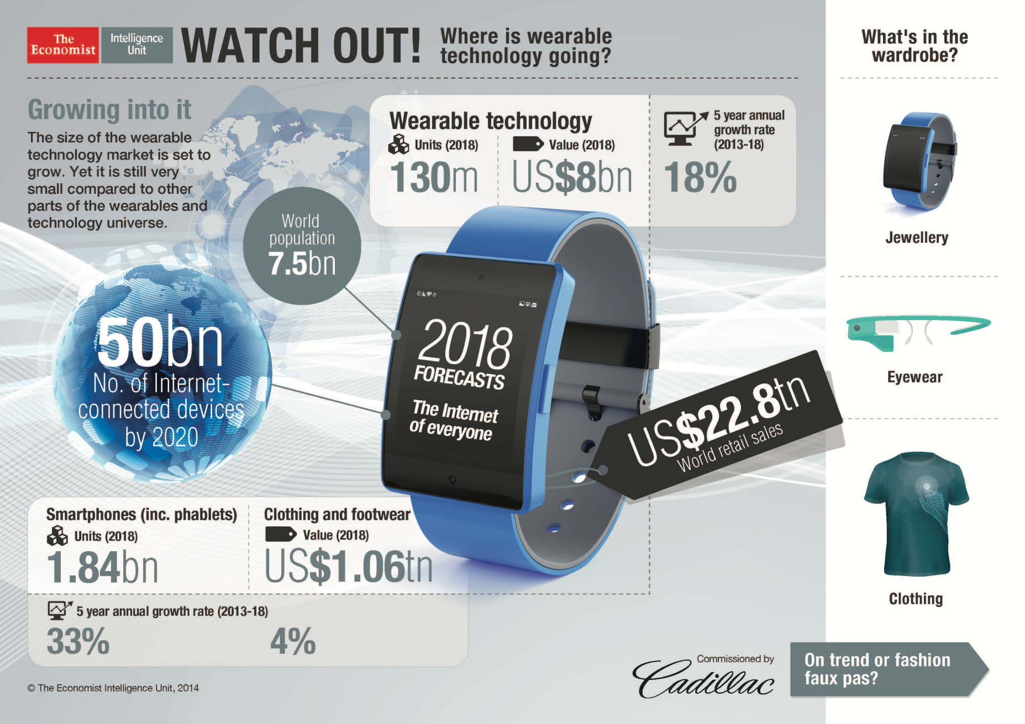
More connected wearable devcies

Slide 13
Making S-E-N-S-E of the Internet of Things
Key attributes of the IoT and how it
differs from the “regular” Internet
Goldman Sachs, Internet of Things – Volume 1, June 2014
The Next Mega-Trend

Slide 14
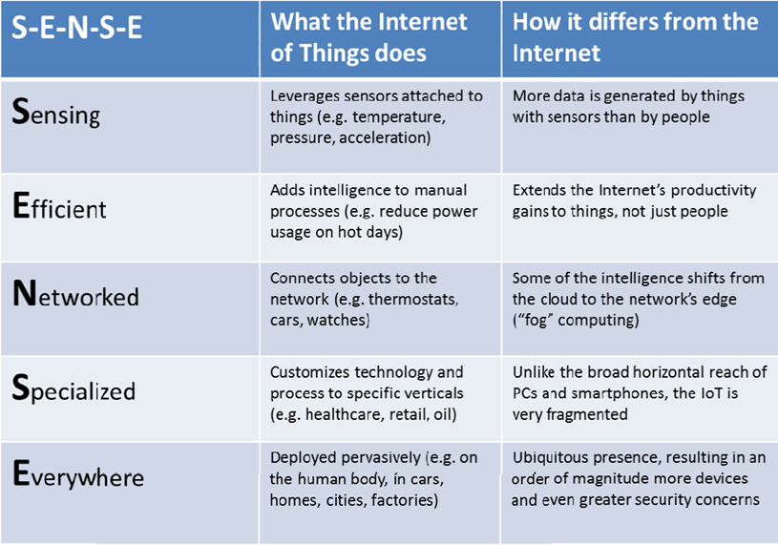

Slide 15

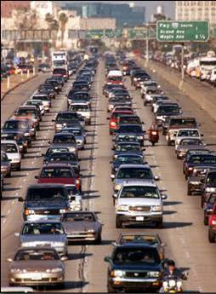
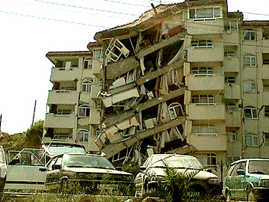
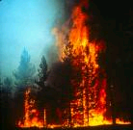
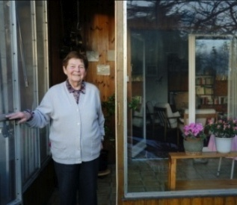
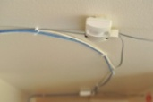
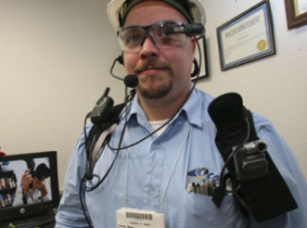
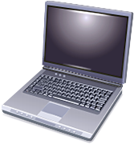


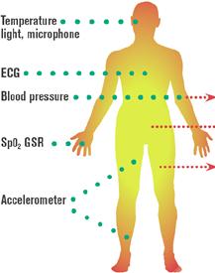
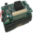


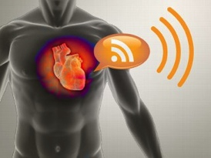
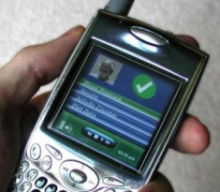
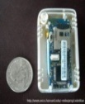
The Age of Observation: Smart Sensing, Reasoning and Decision
Environment Sensing
Emergency Response
Situation Awareness: Humans as sensors feed multi-modal data streams
Percepts (sensors)
Agent (Reasoning)
Pervasive Computing
Social Informatics
Actions (controllers)
People-Centric Sensing
Smart Hearth Care
Sense
Assess
Intervene
Evaluate
Identify
Public Sensing
Social Sensing
Personal Sensing
Source: Sajal Das, Keith Marzullo
Credit: Image courtesy of University of Florida
Notes:
15
Dr. Farnam Jahanian, assistant director, NSF
The melding of the cyber world with the physical world, a trend that will continue to accelerate in the coming decades as a breathtaking pace of advances has brought computing and communication into all facets of our society, and allows us to record and observe a wide set of phenomena:
-- sensing environmental information (air quality, beech erosion),
-- physical structural information (health of bridges and buildings, power consumption of buildings and campuses)
-- social data
and health information.
In our community, this is being ushered in by widespread deployment of low-power sensors ranging
-- from tiny specialized communicating processors (“smart dust”) and
-- specialized sensors (in body sensors, structural sensors, power sensors) to
-- mobile phone-based sensors (geolocation, vibration, etc).
Of course, we can often do more than just monitor and observe:
we can combine disparate sources of data to create a deeper form of reasoning, and we can make decisions, i.e. control or react
Instrument, observe, analyze and respond.

Slide 16
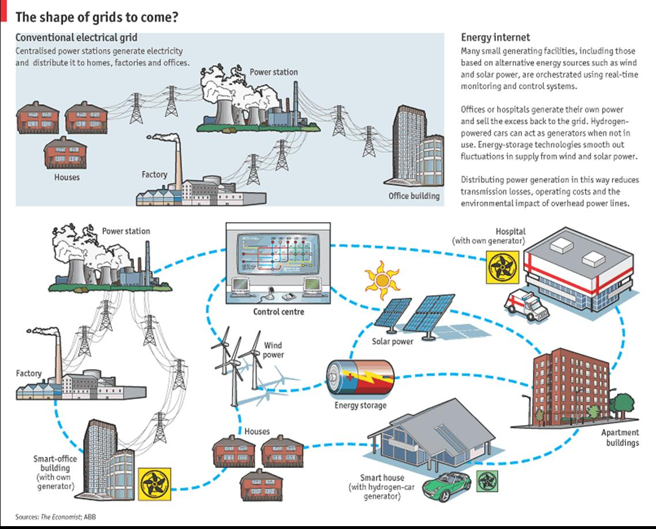
Source: Economist, http://www.economist.com/node/13725843

Slide 17
Smart Objects
“Smart Objects” contain
Microcontroller (the “controller”)
Sensor
Actuator
Network interface
IoT equals;
Controller + sensor + actuator + network access

Slide 18
IoT Enabled “Things”
Important components of IoT enabled devices
Sensors
Actuators
Microcontroller
Network interface
Identification (Radio-frequency ID tag; RFID)

Slide 19
Types of Sensors
Image and Camera devices
Temperature, pressure, force
Proximity and motion sensor
Inertial devices
Examples; accelerometer, potentiometer
Optical devices

Slide 20
Actuators
Actuators;
Receives a control signal from a microcontroller
Based upon input from a sensor
Interacts & changes one or more environmental characteristics
Classification of actuators
Hydraulic
Pneumatic
Electrical
Mechanical

Slide 21
Embedded Systems
Sensor, dedicated controller, & actuator within a product or system
Medical devices
Automotive systems
Emission systems
Transmission control and cruise control
Fuel injection
Anti-lock brakes
Digital cameras
Consumer electronic devices
Many others

Slide 22
Embedded Systems with Network Access
Subset of embedded systems
Usually a dedicated, single-purpose device
Senses a variable in the environment
Process (analyze) the data
Controls one or more variables
Wireless capability
Resource constraints
Power, memory, processor performance
Driving force behind IoT

Slide 23
Network Interface
Two major functional components
Baseband processing
Modulator/Demodulator, amplifier, and filter
An important network interface;
5G wireless networks
Active area of research and development

Slide 24
5G Mobile Wireless Networks
Very high data rates
Typically of Gbps order
Extremely low latency
Significant increase in base station capacity
Driving forces for 5G include;
Growth of smart devices
Multimedia applications (increase revenue?)
Video conferencing, streaming video, e-healthcare, online gaming
Continued growth in wireless data demand

Slide 25
Major Requirements of 5G
Data rates of 1 to 10 Gbps
Almost ten times LTE
Round-trip latency of 1 msec
4G (LTE) has 10 msec round-trip latency
Enormous number of connected devices
Thousands of devices per cell
Significant increase in availability & coverage
Available almost everywhere and at all times
Reduction in energy by ≈ 90%

Slide 26
Centralized Architecture; Cloud RAN
An important goal for 5G mobile networks;
Significant increase in number of “base stations”
Physical size of base station must be reduced
Goal; base station becomes the size of a wireless access point (as in WiFi networks)
Approach;
Move the processing functions of a base station to the “cloud”
Result; small cell deployment (dense wireless networks)

Slide 27
C-RAN Architecture

Slide 28
Important 5G Applications
Device to Device (D2D) communications
Machine to Machine (M2M)
IoT
Advanced Vehicular Communications (IoV)
Healthcare

Slide 29
Internet of Things (IoT)
Cooperation between devices which are;
Distributed
Autonomously communicating
Heterogeneous
Key components;
Sensor and Actuator
5G wireless interface
Processor (controller) for data analysis
Data storage

Slide 30
IoT Applications
Smart Grids
Smart Farming
Smart Logistics
Smart Industries, Homes, and Cities
Smart Healthcare
Smart Vehicles

Slide 31
IoT
Integration of IoT with the “cloud” for;
Storage and data analysis
IoT architecture
Sensors and actuators connect to 5G wireless network
Storage and data analysis is implemented as a network service (“cloud storage”, “cloud computing”)

Slide 32
Summary
Internet of Things
Overview
Definition
Applications
Role of sensors and actuators
Embedded systems
With network access
Role of 5G mobile wireless networks

